Slide 1
Academy South Robotics Team
First meeting today! (Monday, April 13)
Welcome
What is a robot?
What are we going to do with robots?

Slide 2
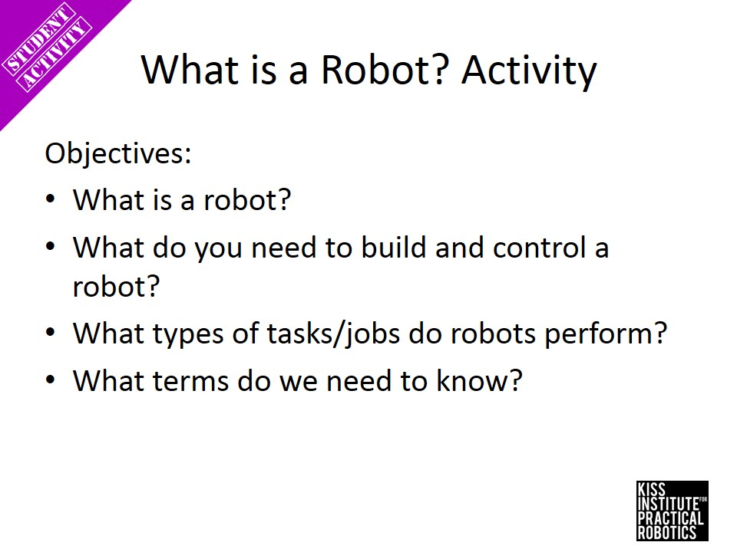

Slide 3
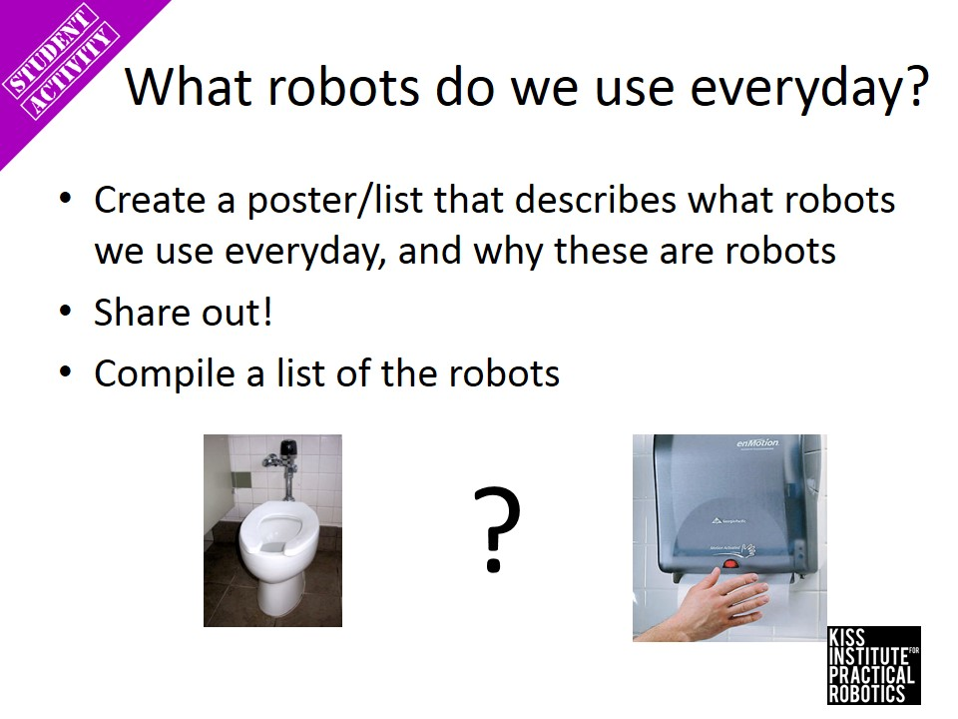

Slide 4
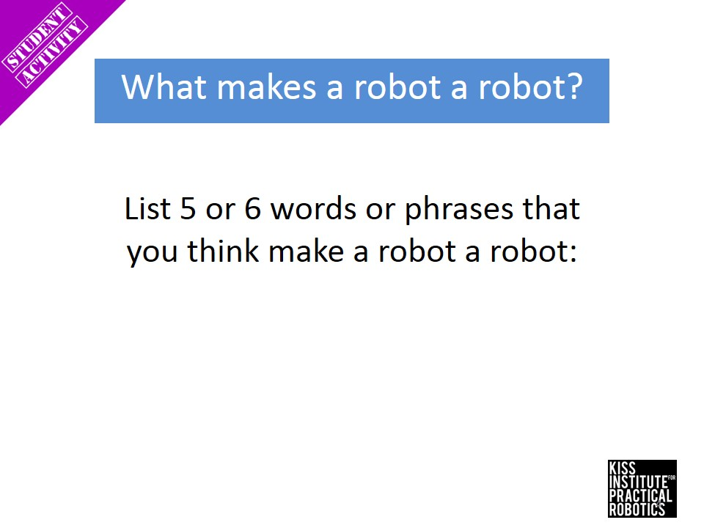

Slide 5
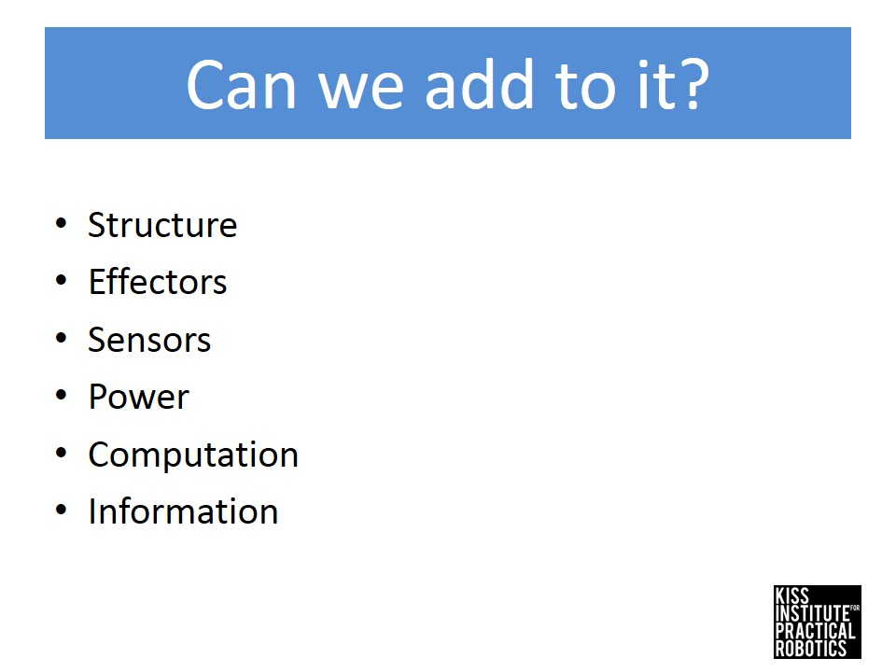

Slide 6
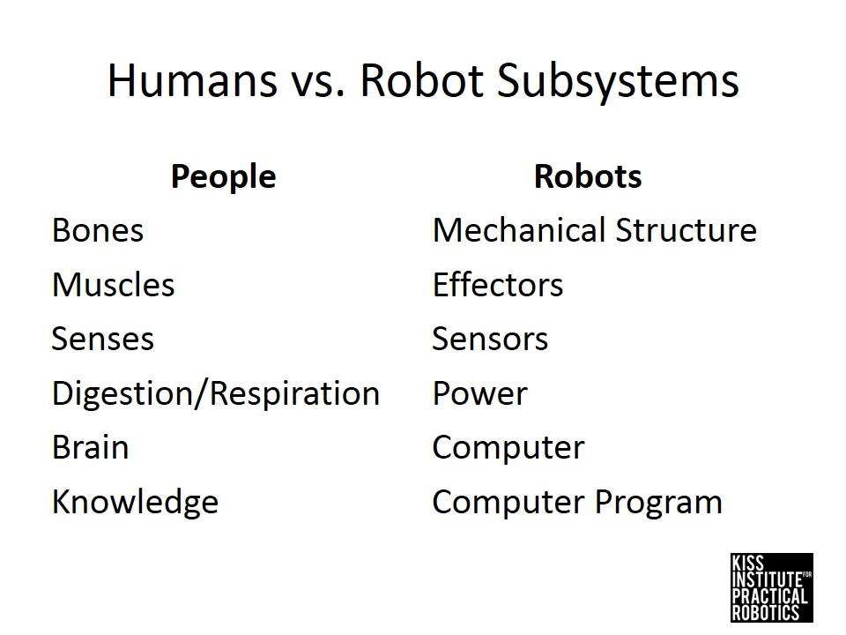

Slide 7
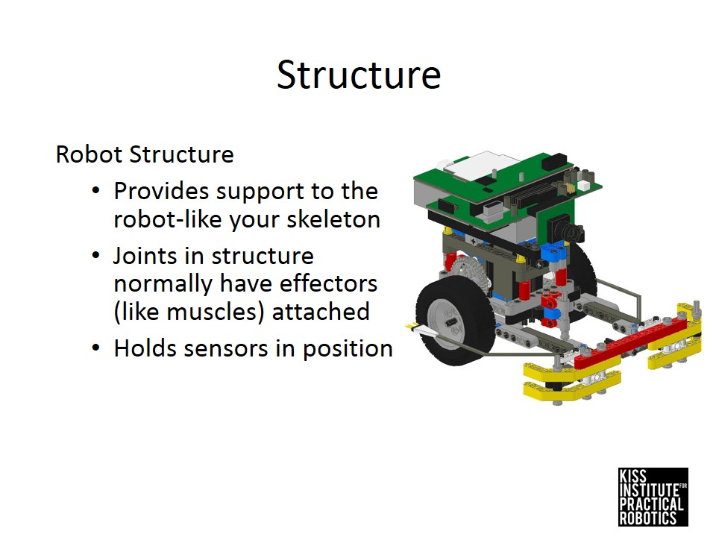

Slide 9
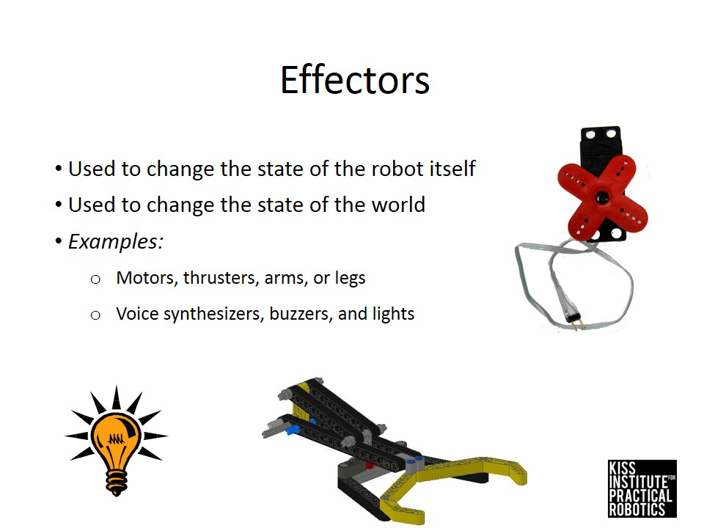

Slide 11
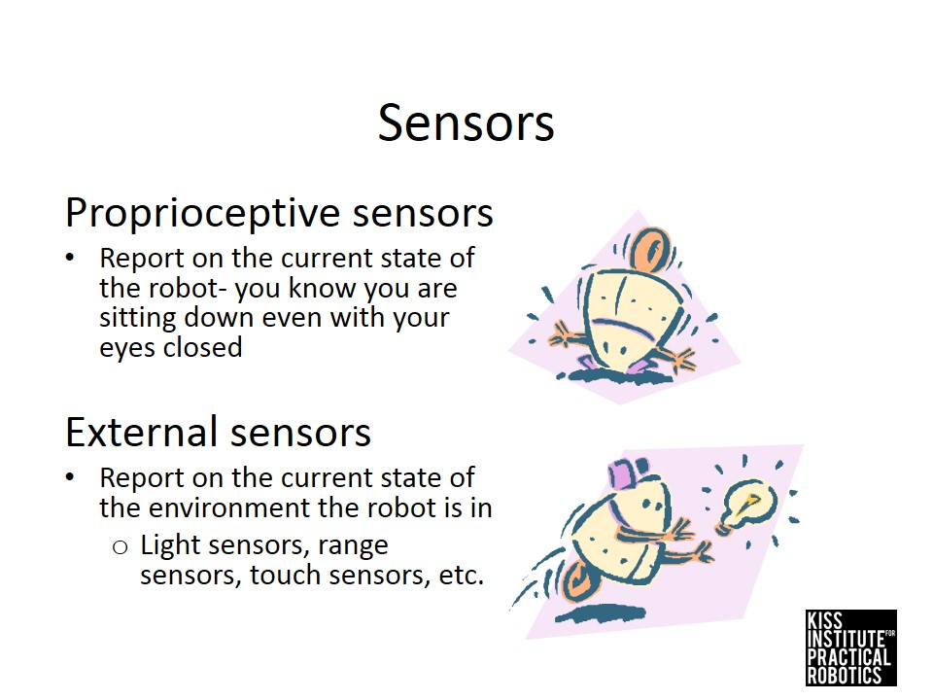

Slide 13
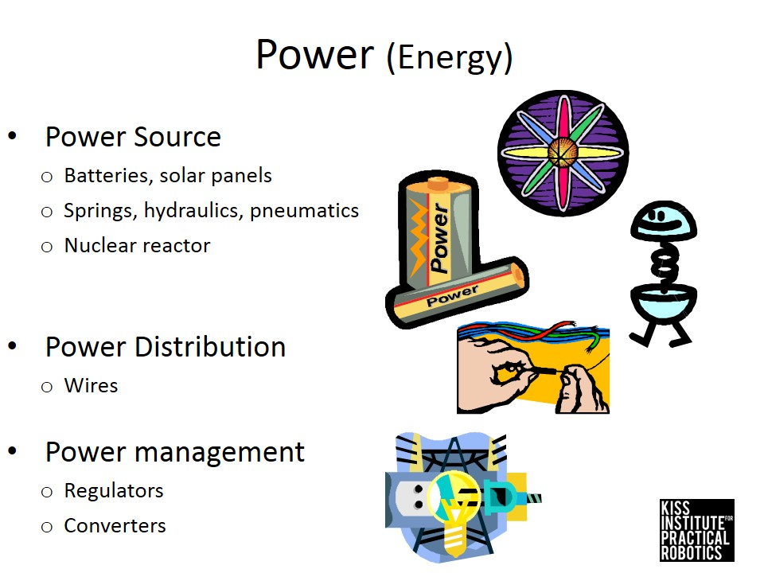

Slide 15
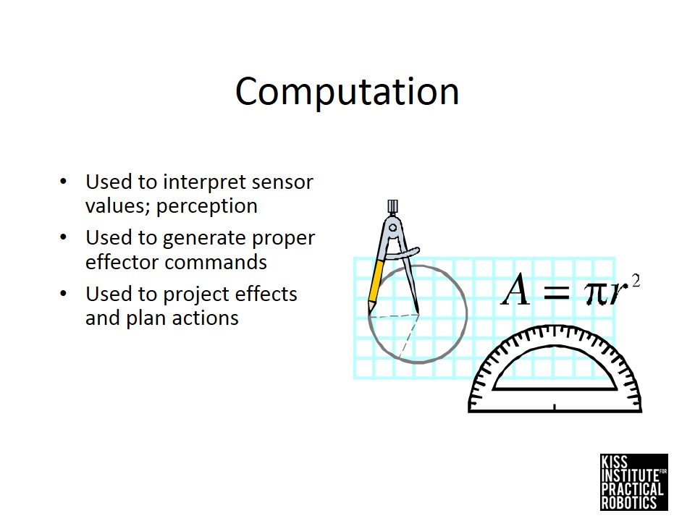

Slide 17
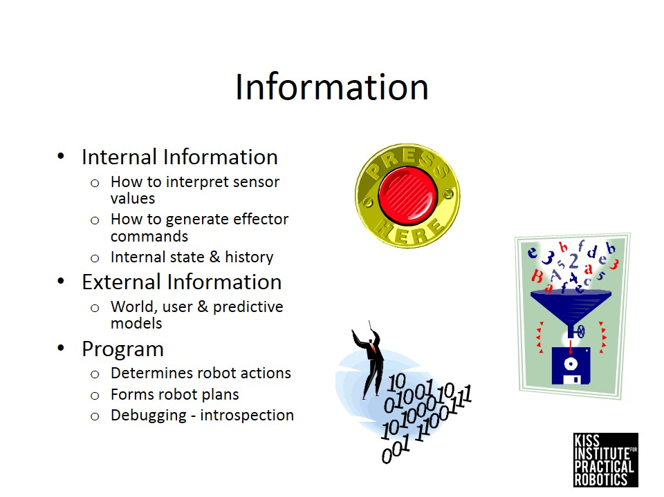

Slide 19
Academy South Robotics Team
First meeting today! (Monday, April 13)
Welcome
What is a robot?
What are we going to do with robots?

Slide 20
Academy South Robotics Team
First meeting today!
Welcome
What is a robot?
What are we going to do with robots?
We will focus on computer programming, which will provide the robot with the knowledge it needs

Slide 22
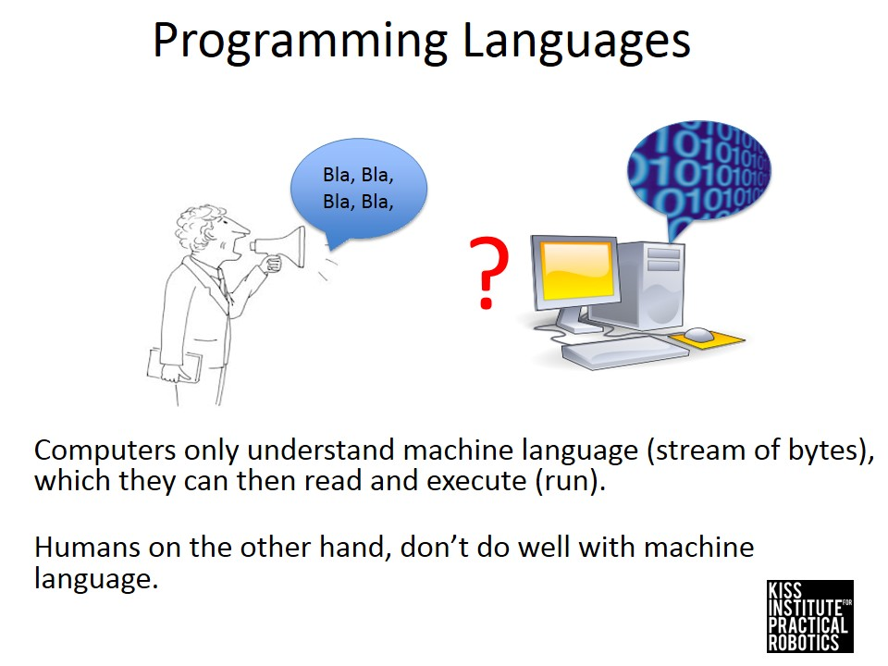

Slide 23
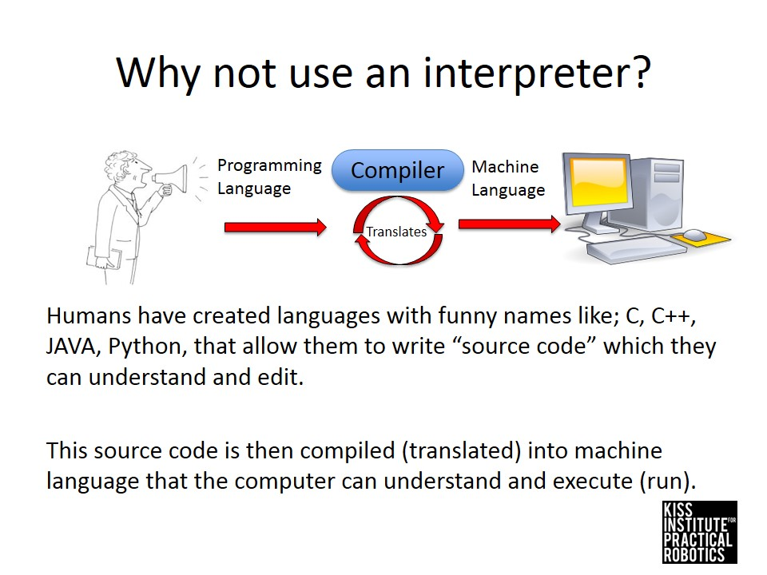

Slide 24
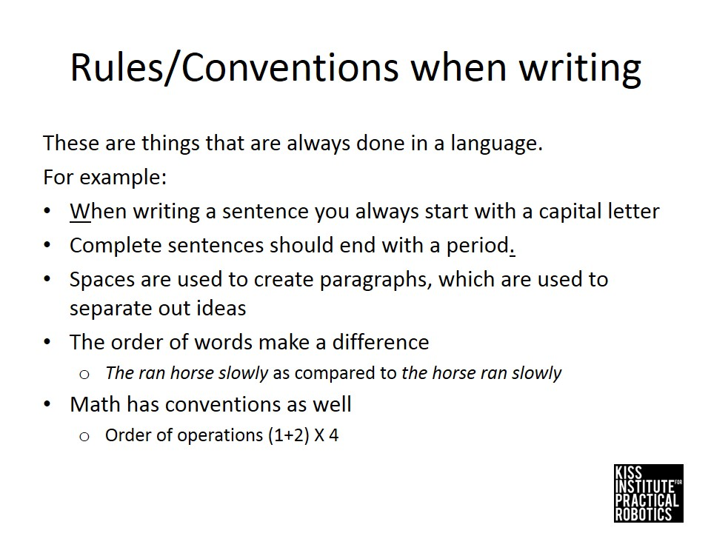

Slide 25
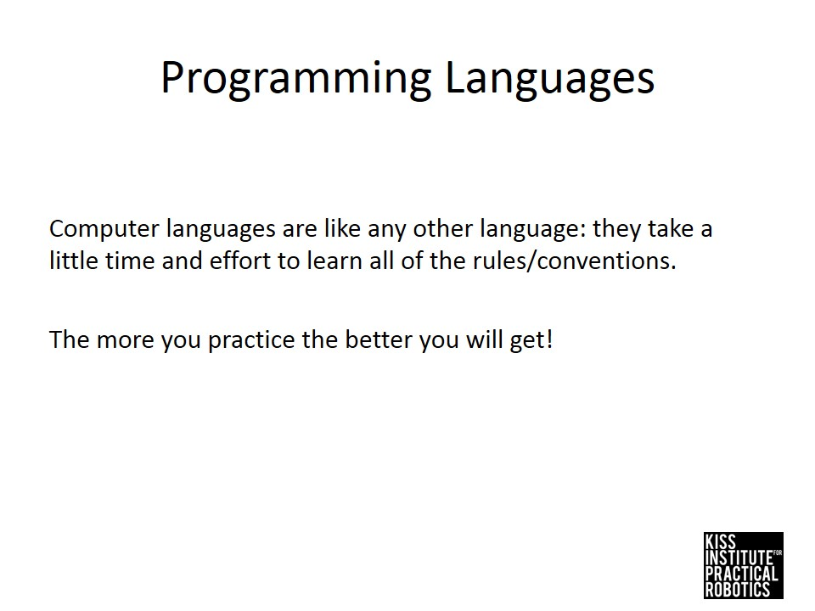

Slide 26
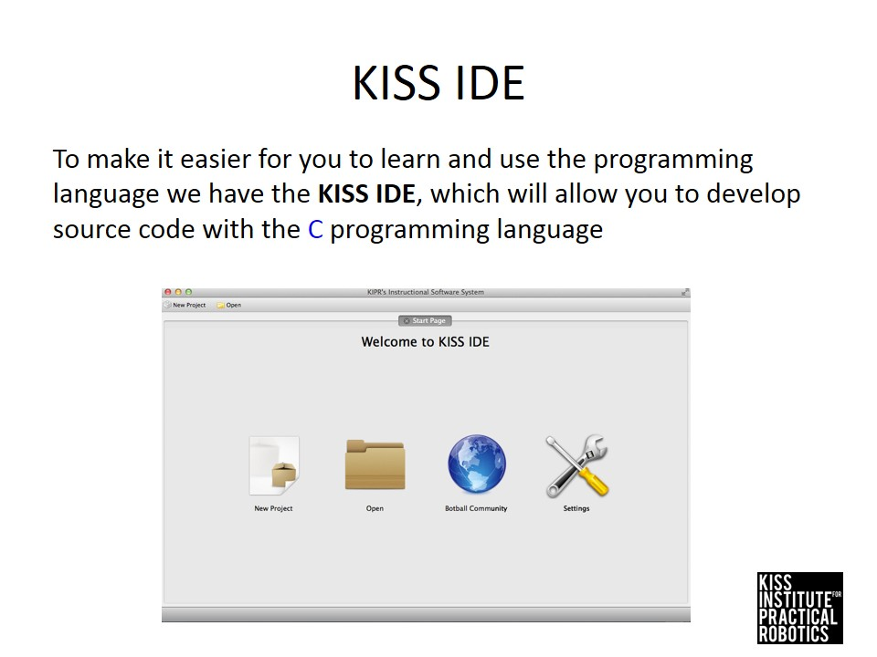

Slide 27
Let’s get on our computers!
We will now:
Open and turn on your computers
Create a folder called “Robot Code” to
store all of our projects
Start the KISS IDE (or “KISS”) app
Let a coach/parent know if you need help

Slide 28
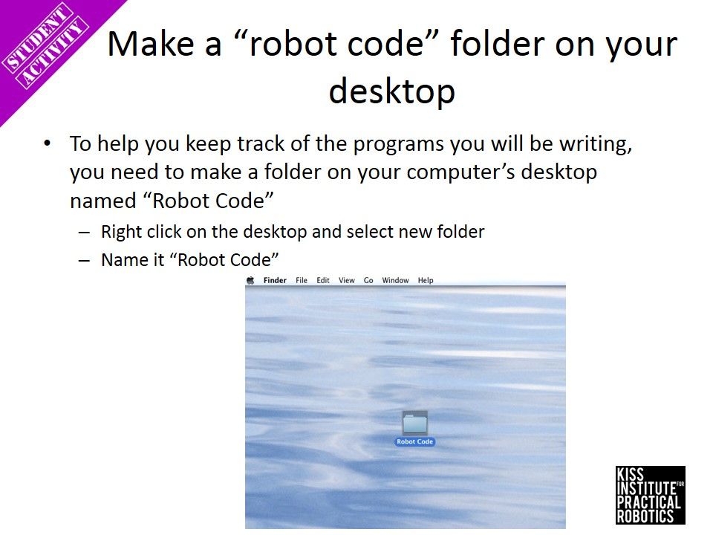

Slide 29
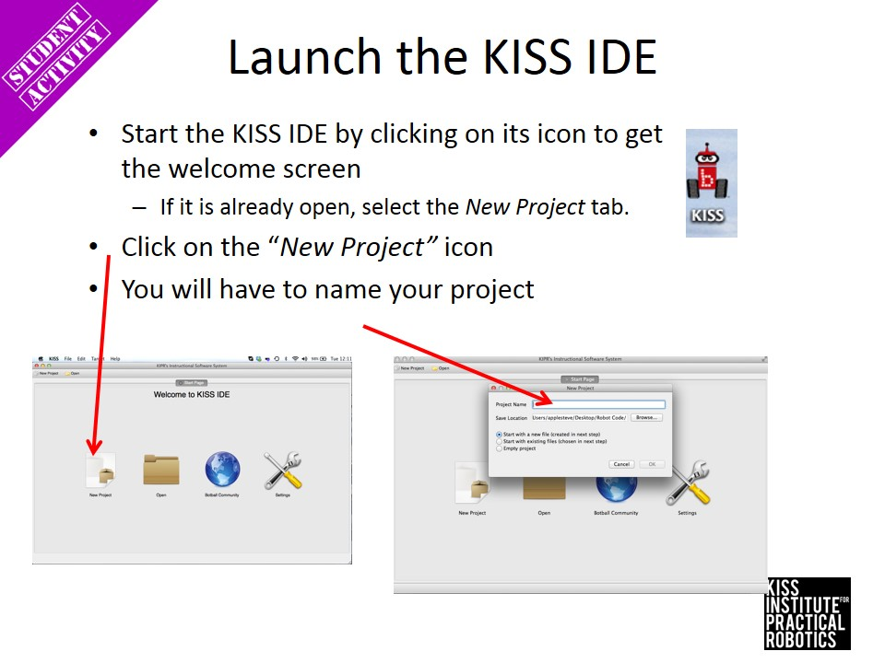

Slide 30
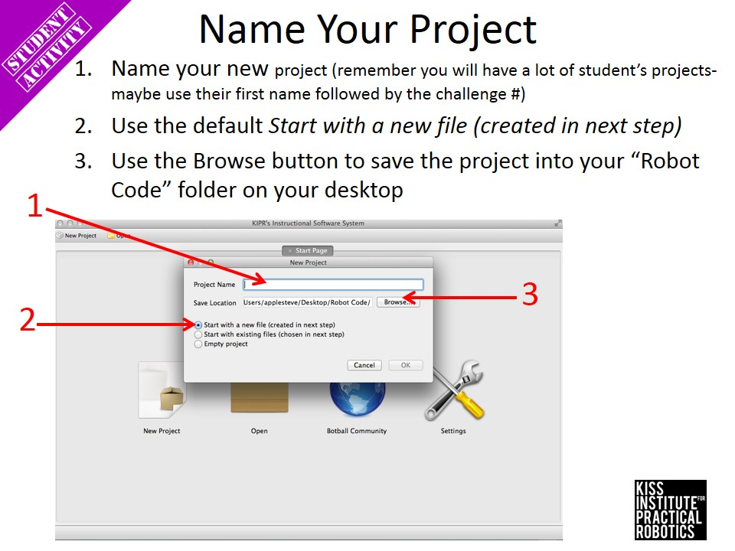

Slide 31
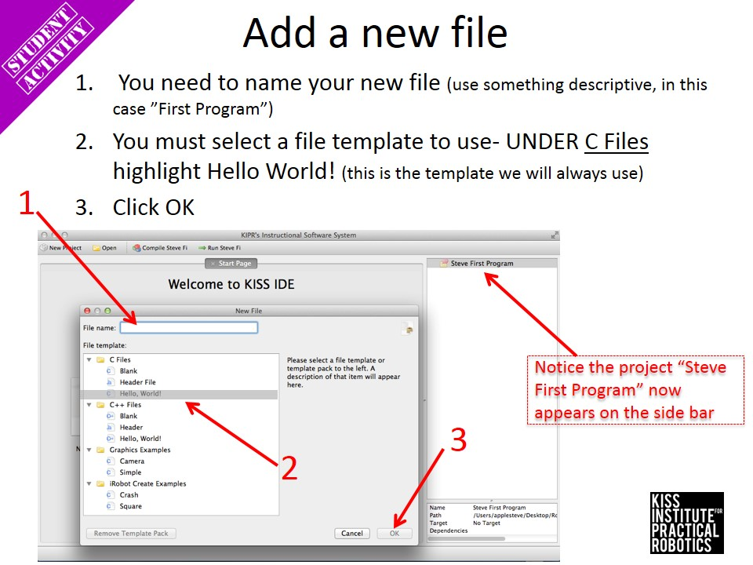

Slide 32
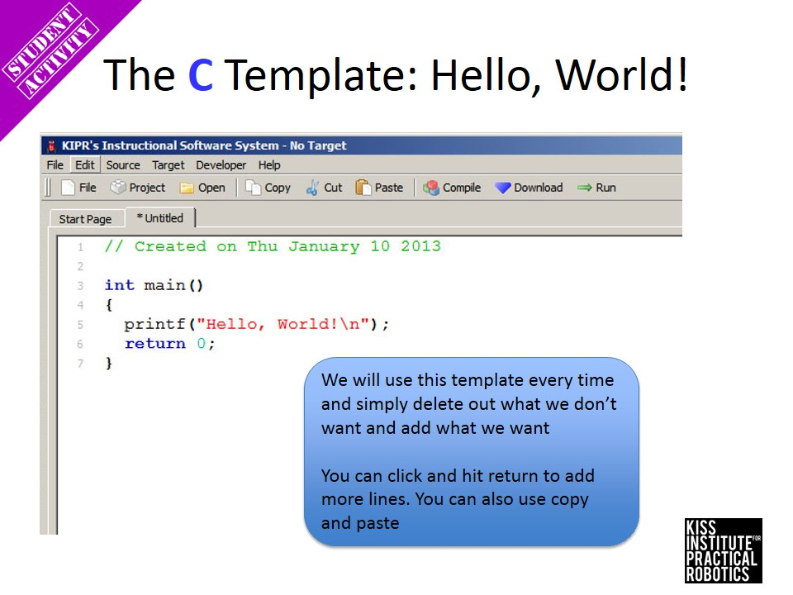

Slide 33
Whatever you put in the quotation marks after printf will appear on the robot
printf(“Hello, World!\n”);
... makes the robot print out
Hello, World!

Slide 34
Think about what you want the robot to say and write it in your notebook
Draw a line down the middle of your page
On the right, describe what you want the robot to do or say
On the left, try to write out the code that tells the robot what to say.
It should look something like:
printf(“Hello, World!”);
Raise your hand to have a coach check your work

Slide 35
Go to your computer now and add your own text. Remember that “\n” makes a new line.
Printf(“Hello, World!\n”);
Printf(“Hi, Mr. Cosby!”);
Printf(“\nAmbrose likes pasta!”);
... makes the robot print out
Hello, World!
Hi, Mr. Cosby!
Ambrose likes pasta!

Slide 36
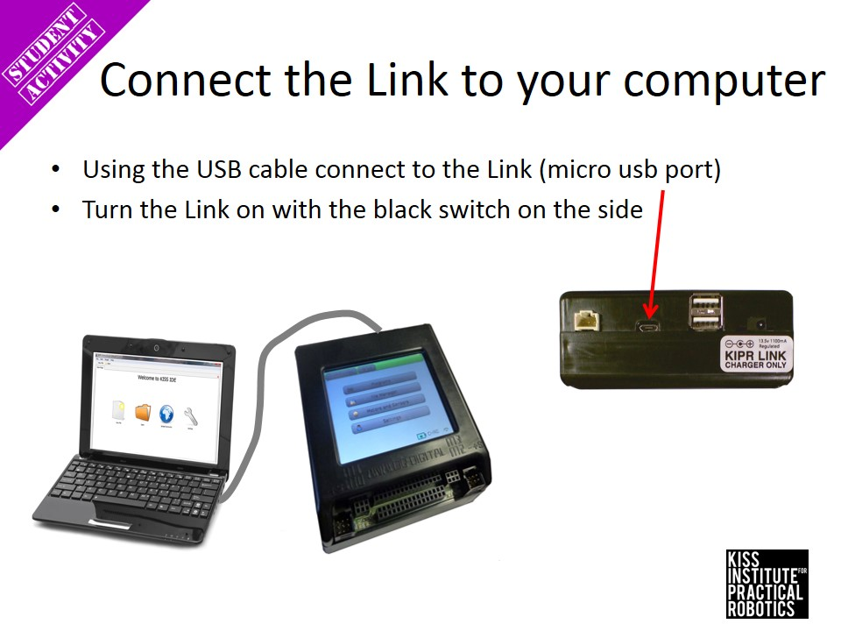

Slide 37
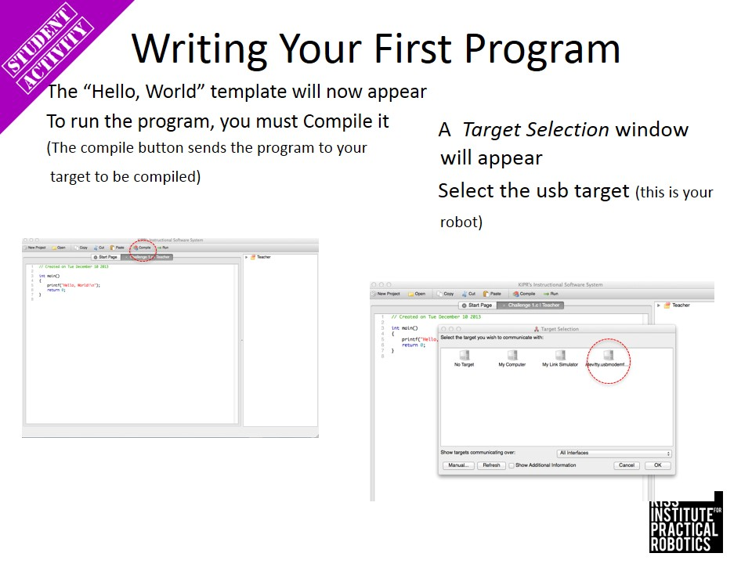

Slide 38
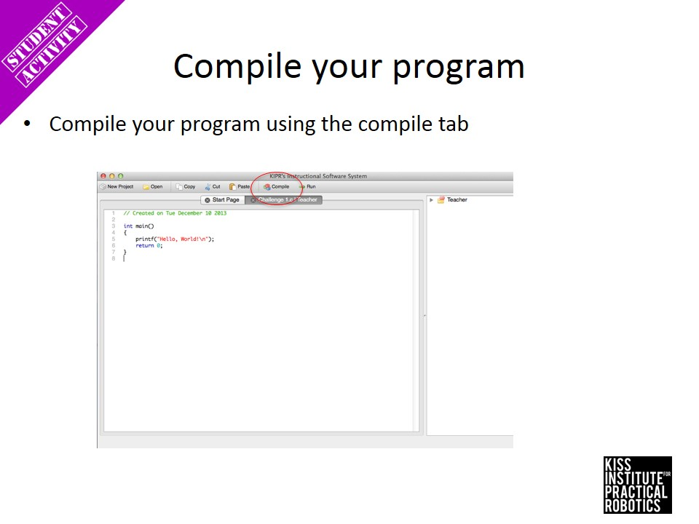

Slide 39
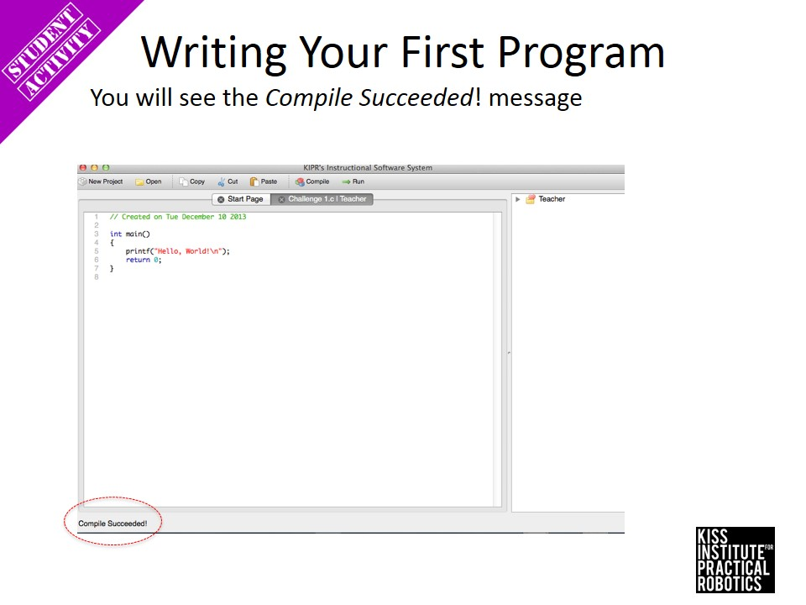

Slide 40
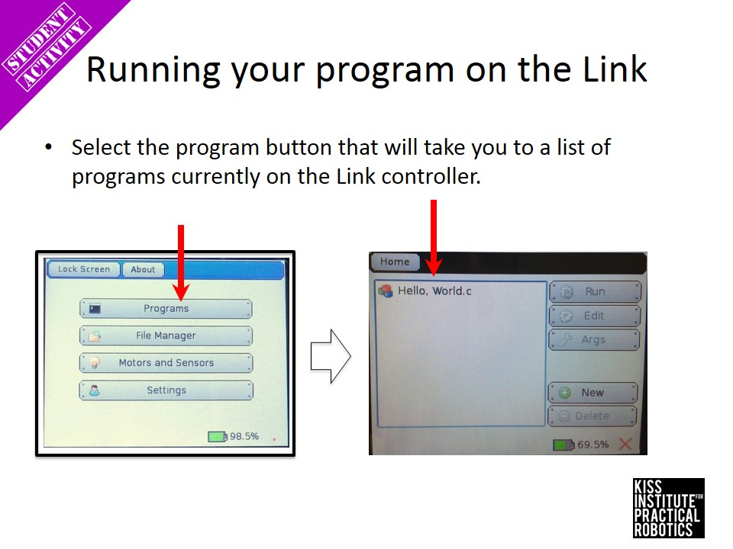

Slide 41
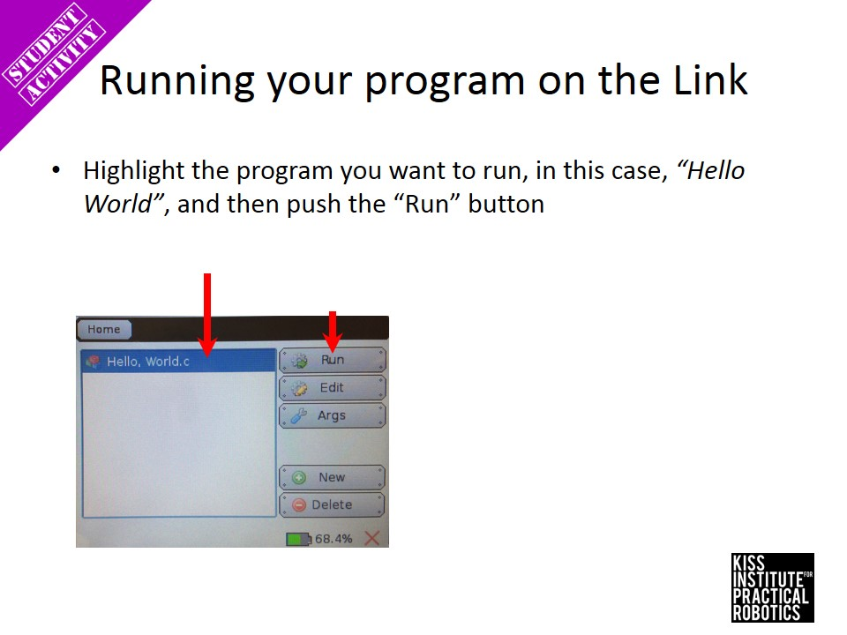

Slide 42
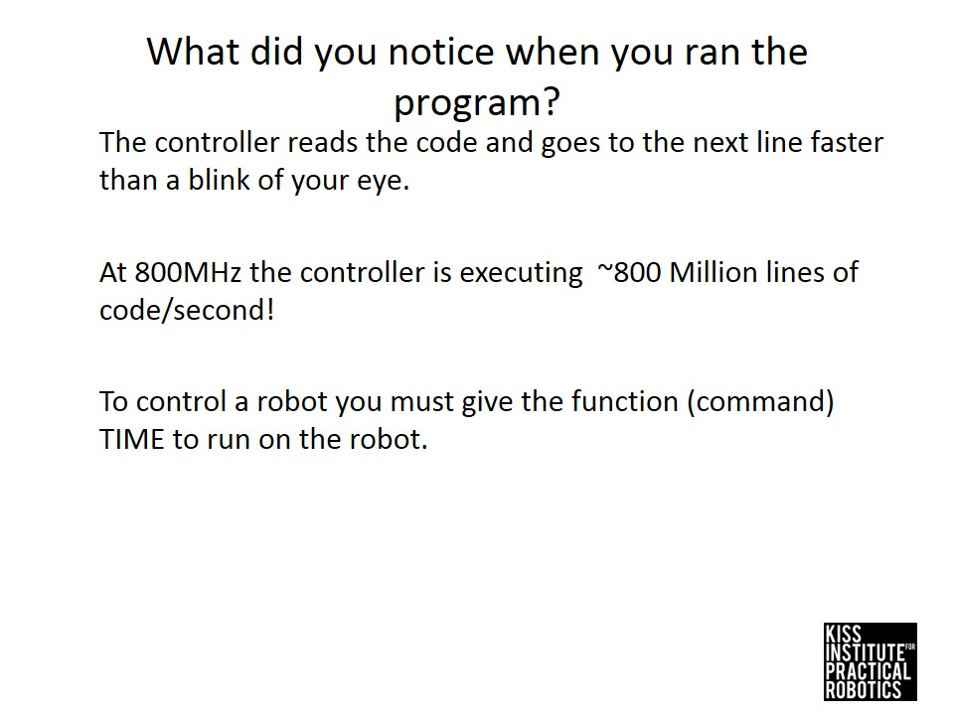

Slide 43
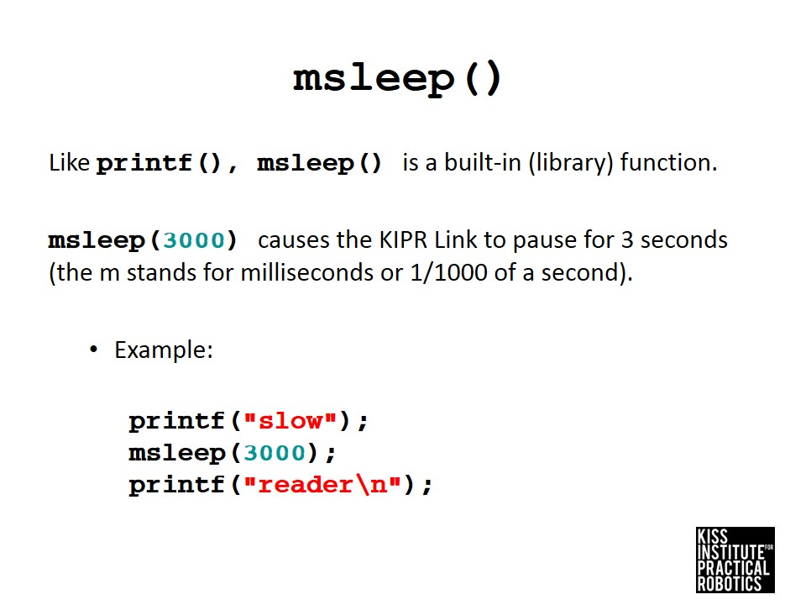

Slide 44
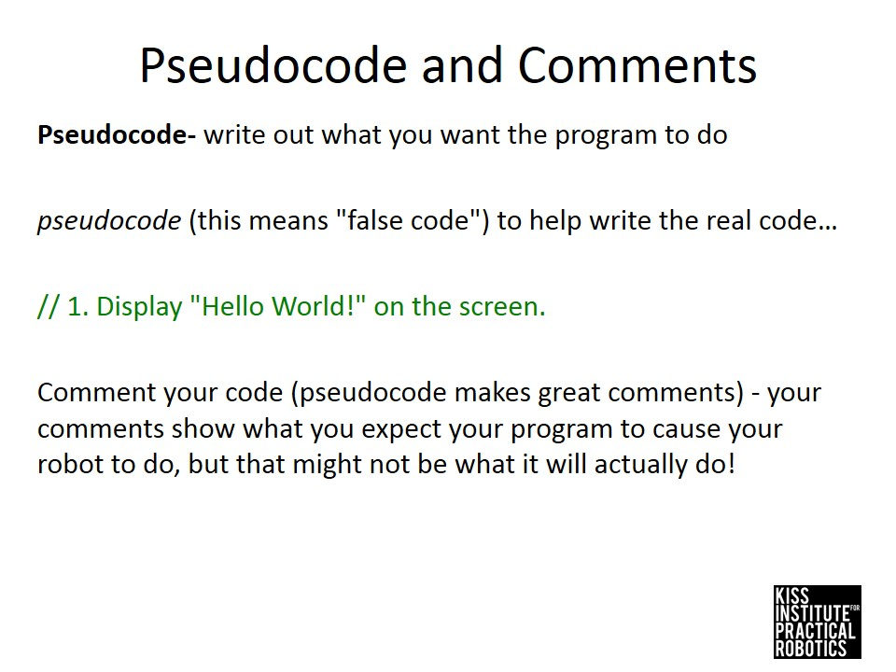

Slide 45
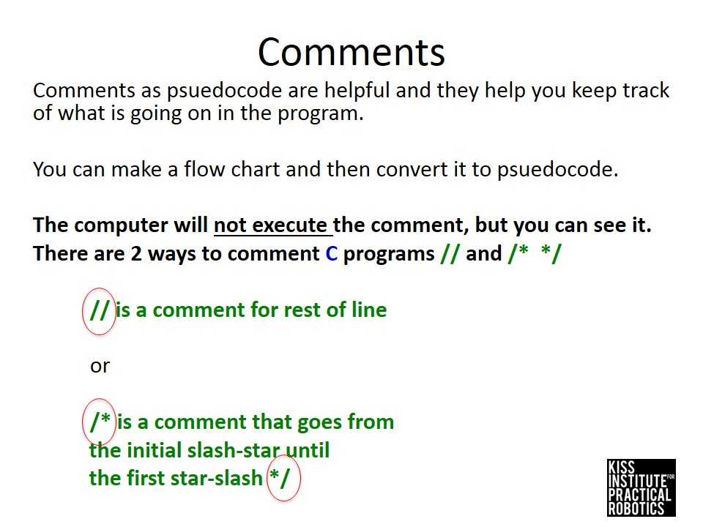

Slide 46
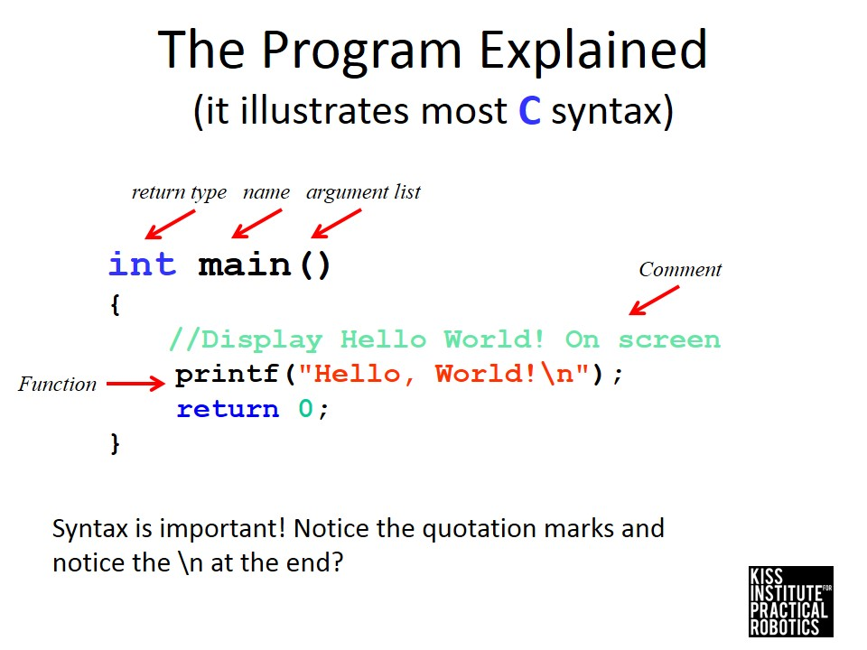

Slide 47
How comments are helpful
Now that we have different functions like printf and msleep, comments help us stay organized
You can put comments to the right side of any line of code just like you had the two sides on your notebook page
You can also put comments to separate sections of code

Slide 49
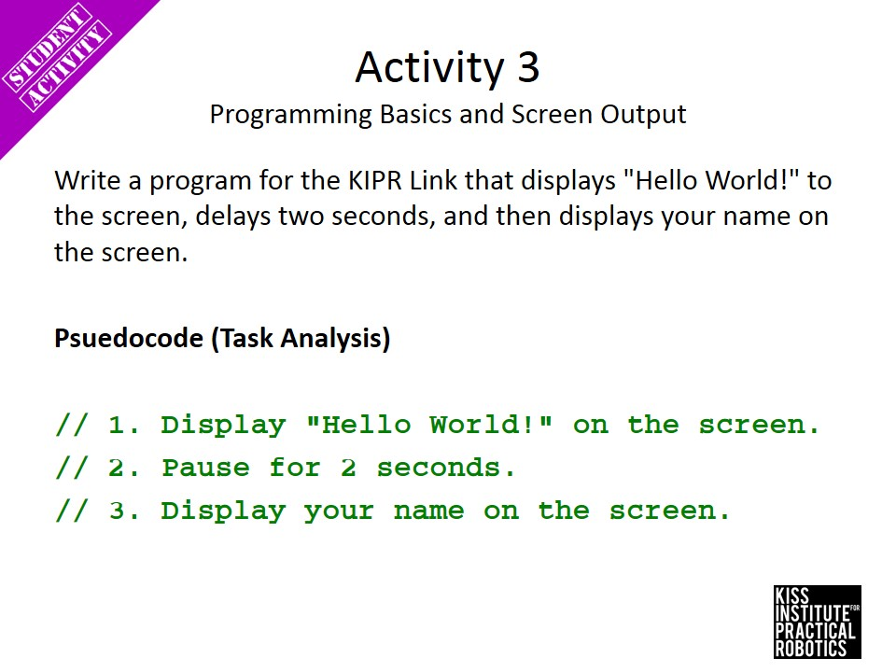

Slide 50
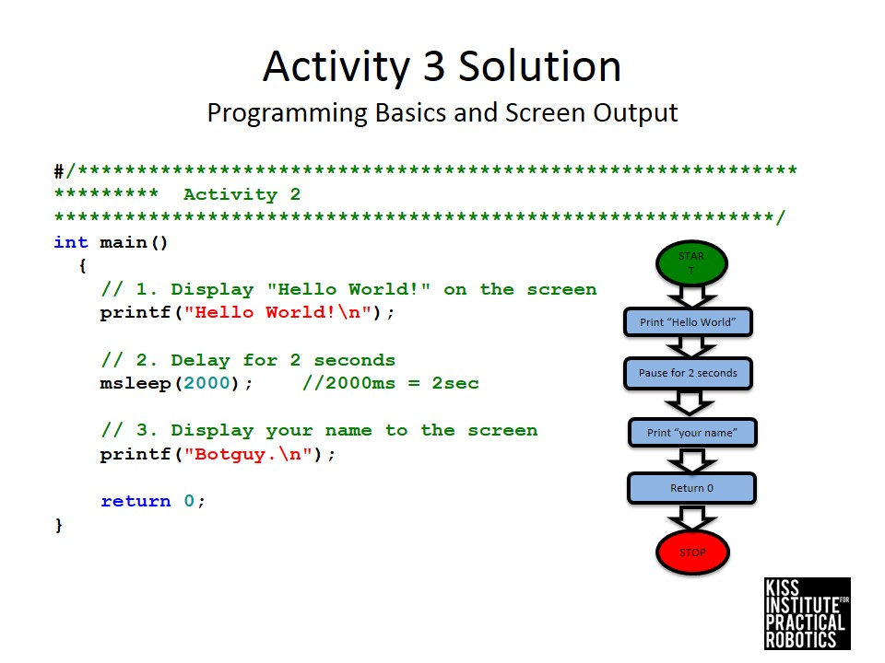

Slide 51
Try compiling and running again!
See if the robot will pause in between saying the different lines of text

Slide 52
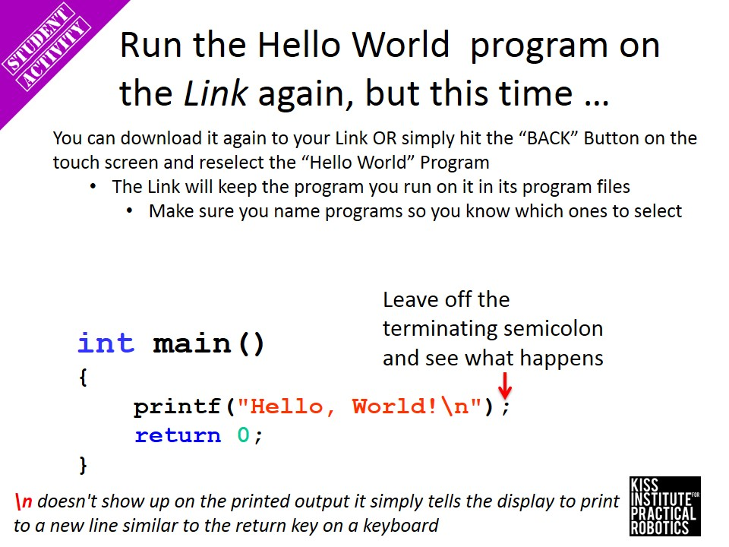

Slide 53
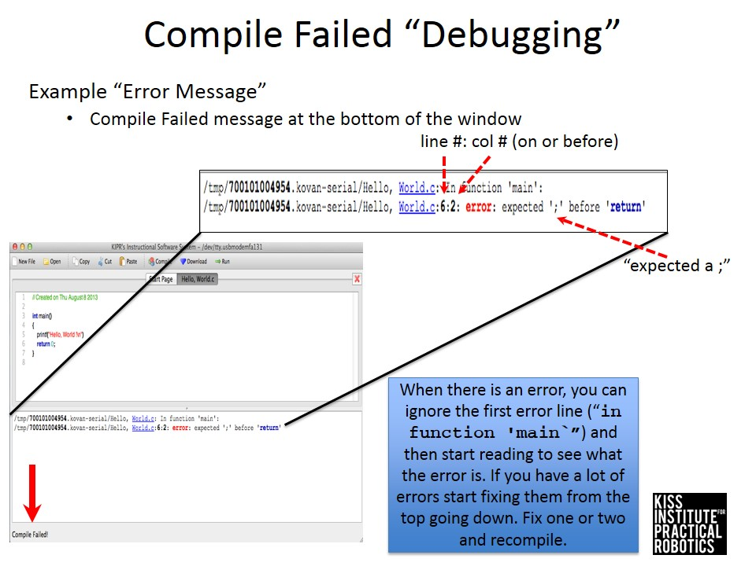

Slide 54
Are you ready for the robot to do something more exciting?

Slide 55
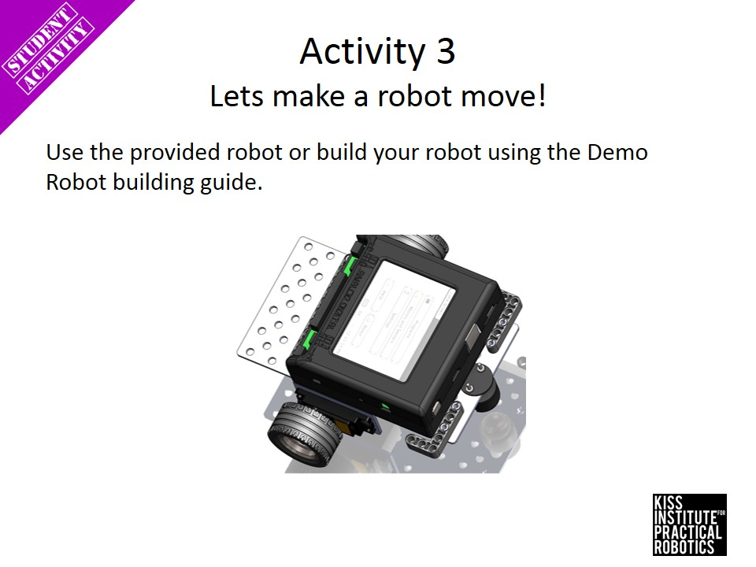

Slide 59
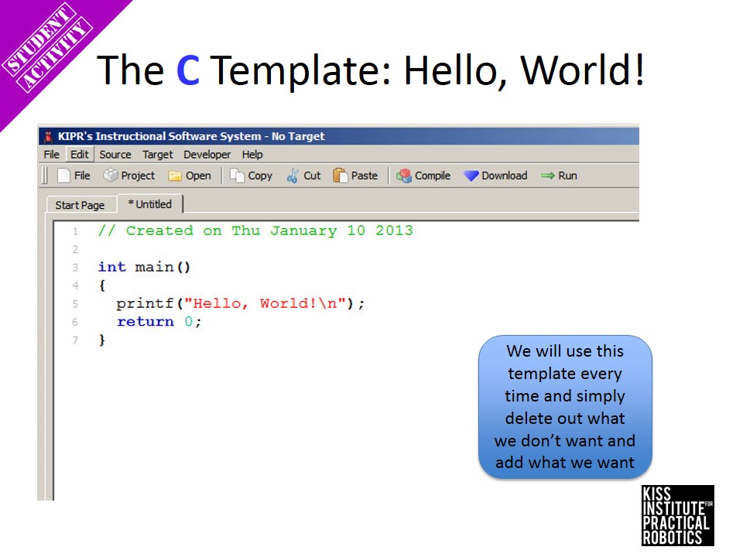

Slide 60
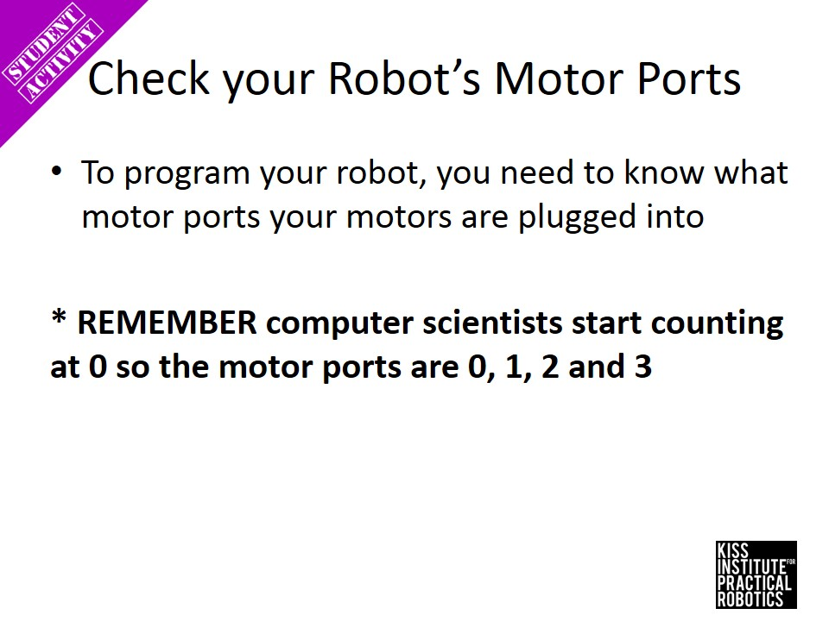

Slide 61
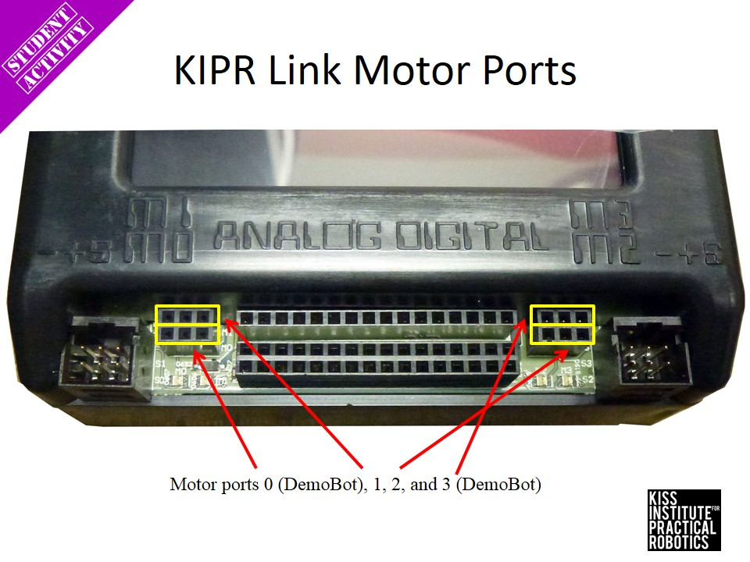

Slide 62
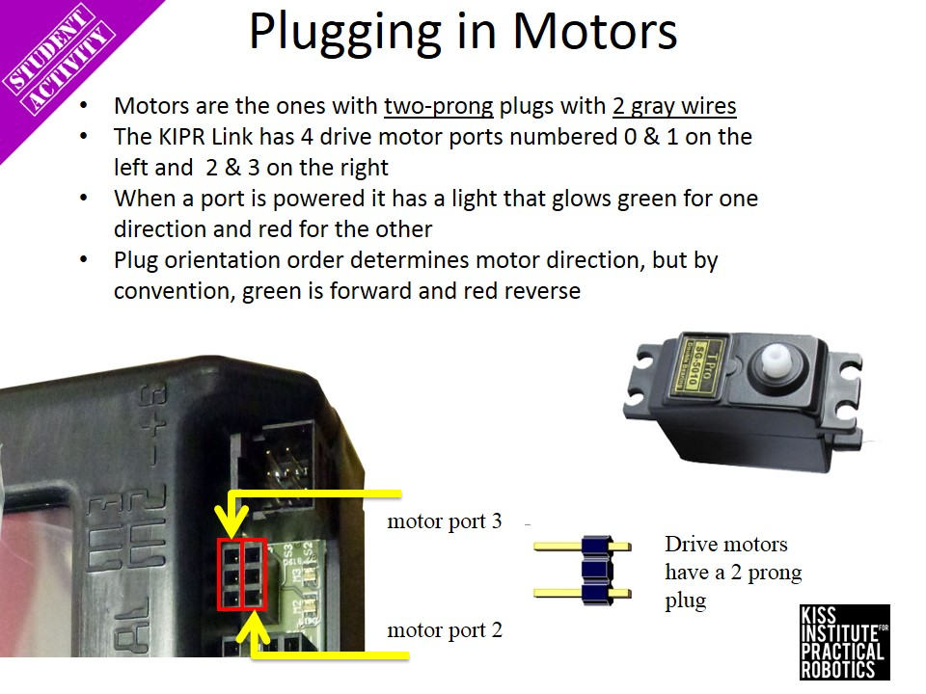

Slide 63
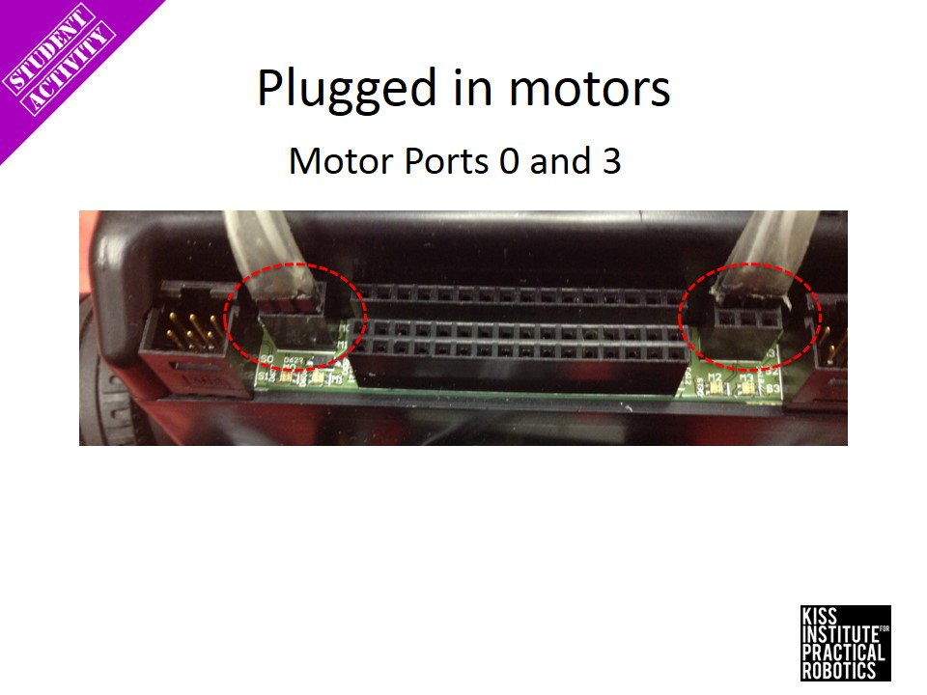

Slide 64
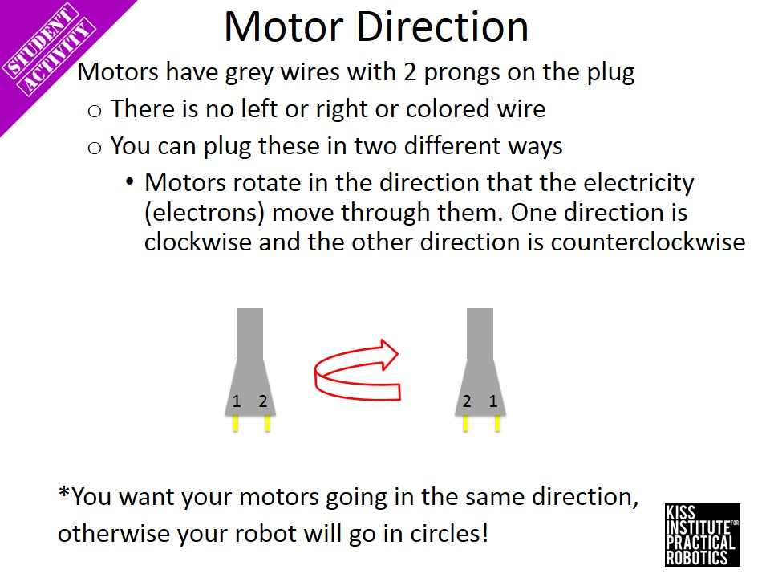

Slide 65
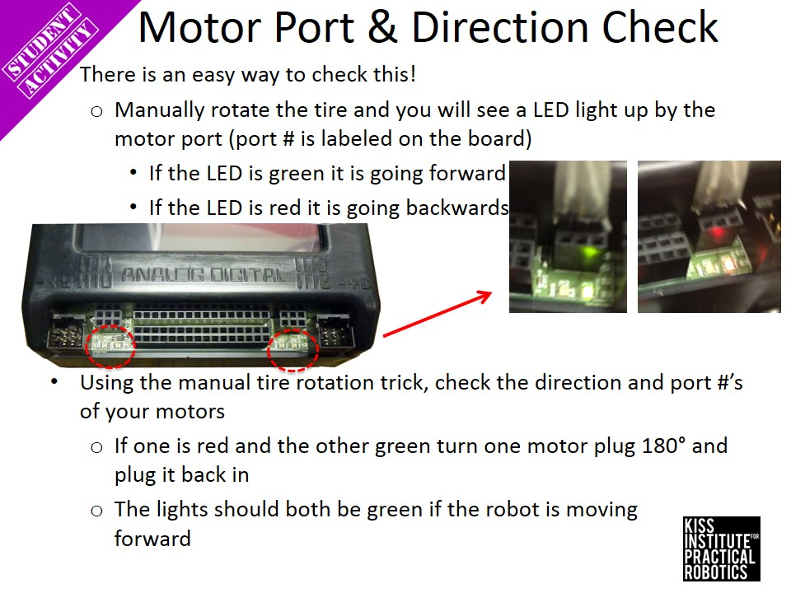

Slide 66
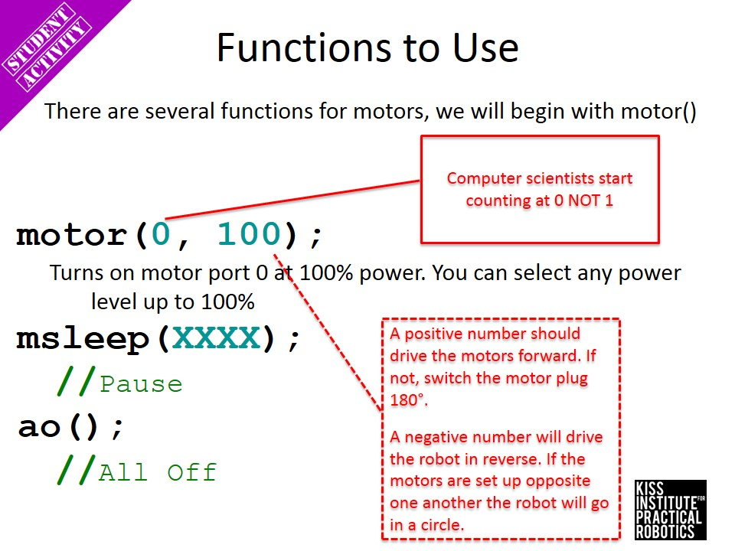

Slide 67
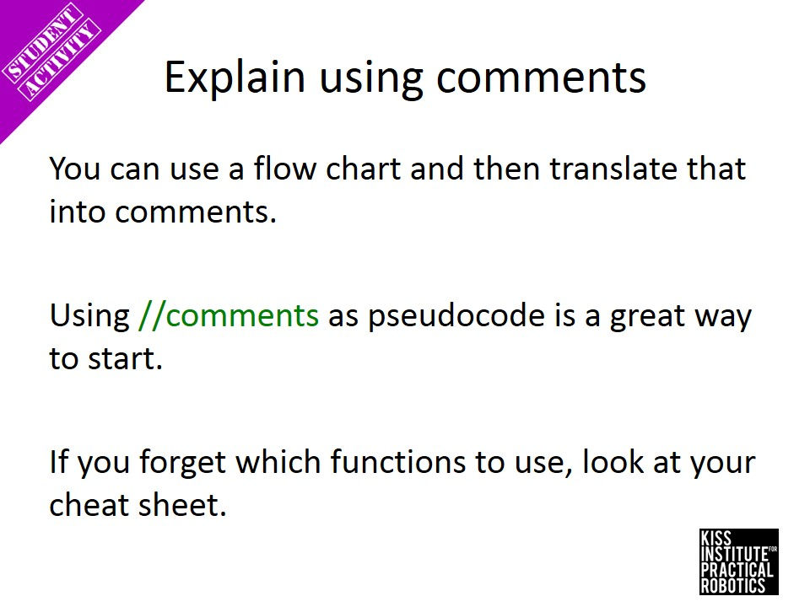

Slide 68
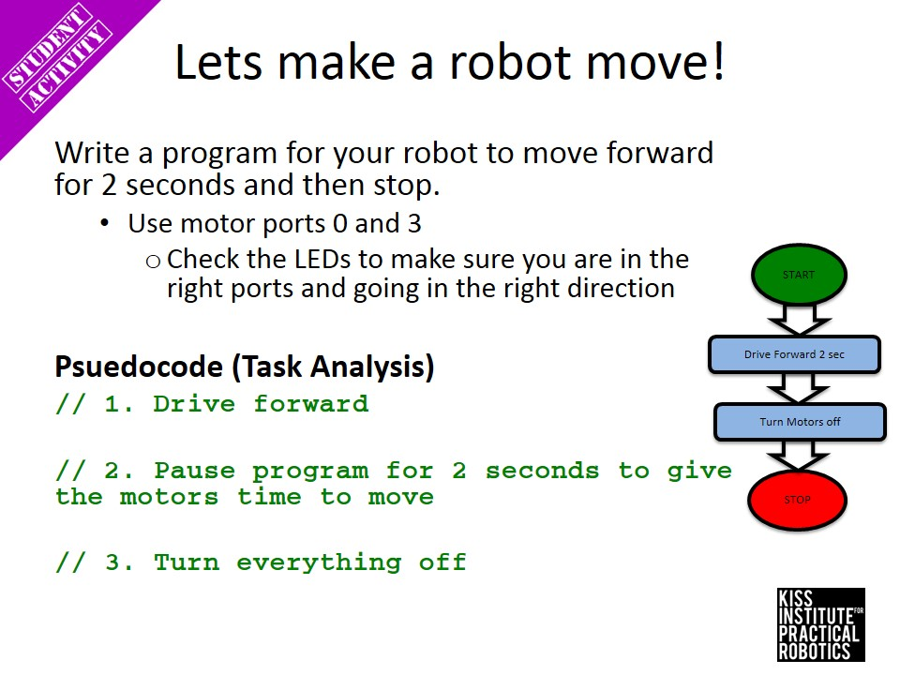

Slide 69
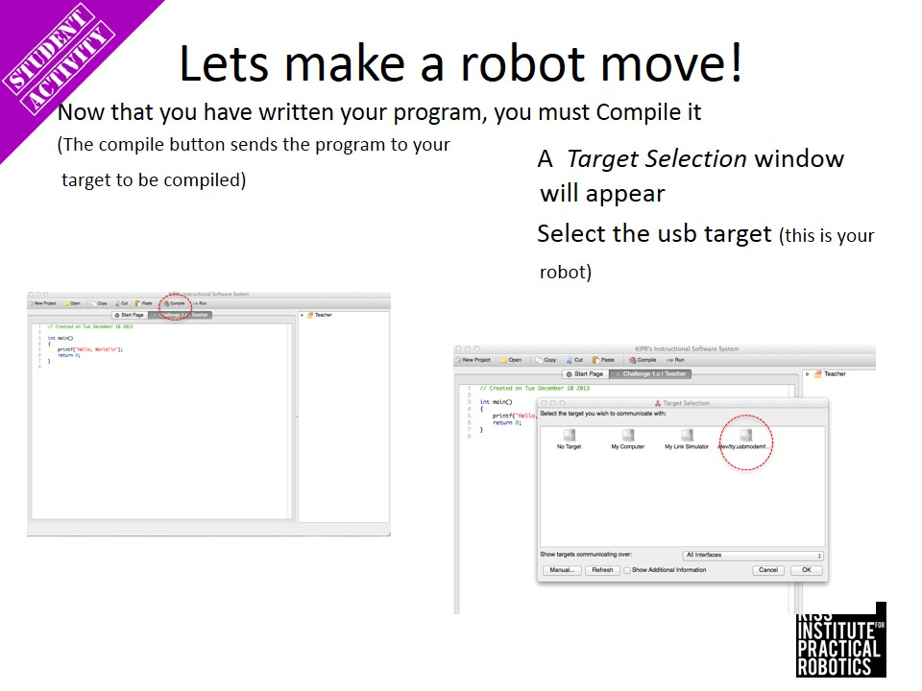

Slide 72
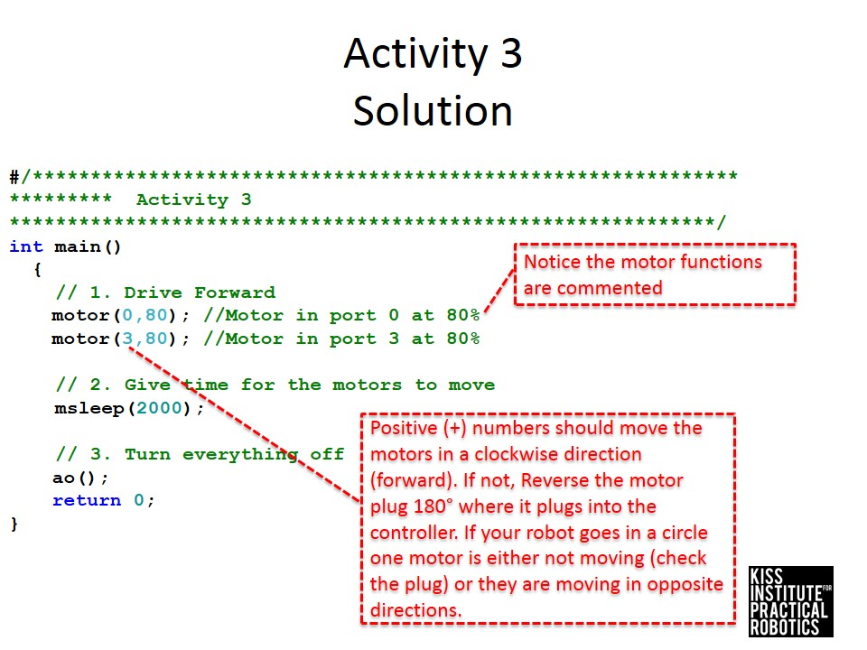

Slide 73
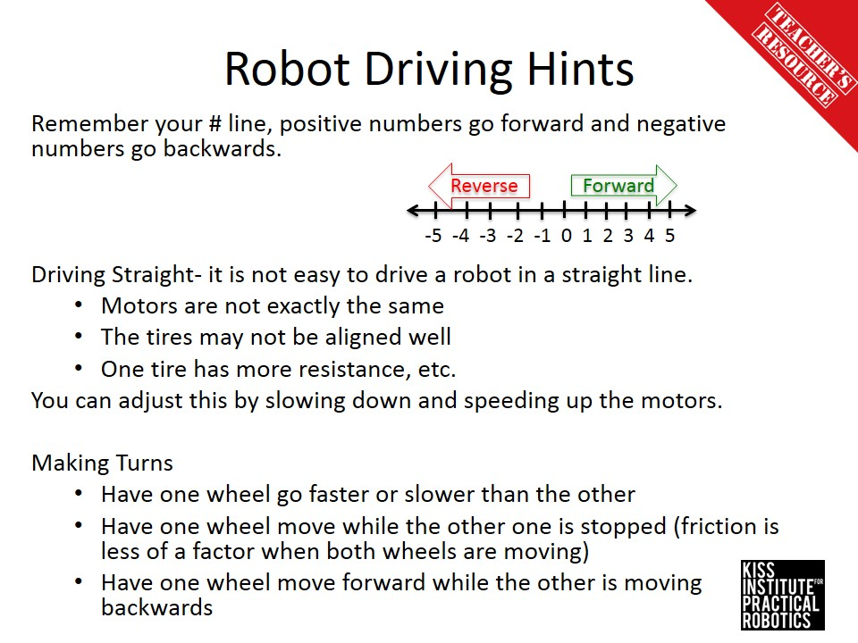

Slide 74


Slide 75


Slide 76


Slide 77


Slide 78


Slide 79


Slide 80


Slide 81


Slide 82


Slide 83


Slide 84


Slide 85


